Slide 1
UNDERSTANDING THE MANPOWER IN JORDANIAN RESTAURANTS
Presented to: JRA & SIYAHA
September 2013

Slide 2
AGENDA
EXECUTIVE SUMMARY
SAMPLE PROFILE
LOCAL VS. FOREIGNER STAFF
REASONS BEHIND RECRUITING LOCALS VS. FOREIGNERS
WHO COSTS MORE? RECRUITING LOCALS OR FOREIGNERS
CURRENT & FUTURE STATUS OF THIS INDUSTRY
IS EFFECTIVE TRAINING NEEDED?
THE INCAPABILITY OF LOCAL STAFF.
RECRUITING METHODS
BENEFITS GIVEN TO LOCALS VS. FOREIGNERS
LOCAL HOSPITALITY GRADUATE

Slide 3
STUDY BACKGROUND
The Jordan Restaurant Association (JRA) was created by the Ministry of Tourism & Antiquities and empowered by law no. (47) in 2002 to represent and serve the growing restaurant industry in Jordan.
Recently the Ministry of Tourism & Antiquities issued a law that encourages restaurant owners to replace all foreigners staff with Jordanians.
Therefore, JRA wants to assess the status of this industry in Jordan.
To this end, Nielsen conducted this project using a quantitative approach, face-to-face interviews were taking place using a structured questionnaire.
At the beginning there was a high rejection rate but in cooperation with JRA field work went smoother.
Unfortunately Fast Food 3 stars could not been interviewed. This category contains 2 venues only & reason is high rejection & unavailability.

Slide 4
NOTES FOR READING THE REPORT
All figures presented here are in percentages, unless stated otherwise and written on the chart: “Absolute Numbers”
Question numbers along with it’s text as in the questionnaire are listed at the bottom left of the slide.
All the answers & numbers in this report is based on the say of the respondents (the sample)
Should client be interested in any additional analysis beyond what is presented in this report, client is to get back within 1 week of the delivery of this presentation for the extra analysis to be processed and done.

Slide 5

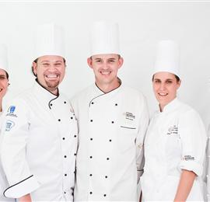
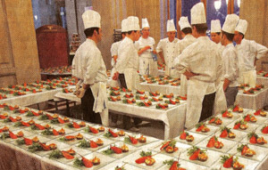

EXECUTIVE SUMMARY

Slide 6
The findings of this survey supports the following points:
Foreigner staff represent around 31% of all staff of the targeted sample.
Foreigner staff allocates the positions which needs wide experience along with skills (such as: head chef, chef assistant, sous chef, etc.), & the low level positions that Locals do not apply for since the culture of shame they suffer & they can not work under such kind of pressure (such as: Housekeeping, Argela, Kitchen steward employee, etc.)
The dominant nationality of the foreigner staff in this sample is “Egyptian” .
Male is the dominant gender in all the positions in this industry that locals hold (regarding this sample), this is a result because of:
Unavailability of female worker to apply.
Culture of shame, which is the obstacle not for females, it is also for males to be part of this industry.
Nature of the work & troubles of it that females can not handle. In addition to that girls can not stay working late.
Venues that employ foreigners disclosed the following reasons behind this:
Foreigners accept lower wage comparing to the load of work they would be under. Talking about wage over here not the total cost of the foreigners.
Foreigners are humble; accept any kind of task to do even if it is considered a lower one.

Slide 7
Stability, foreigners are committed to their work, & they do consider it as a career. Unlike the locals who do not have a commitment towards their jobs in this industry, plus what locals suffer from culture of shame that do in many times represent a driver to let them leave their jobs.
They are Patient; capable to work under pressure & for long working hours. Unlike locals.
Foreigners are highly skilled related to the positions that need special skills.
There is around 24% of the sample recruiting 100% locals only. The major players in this area are fast food category& other locations category which include fast food restaurants also).
There are 2 venues that recruit foreigners only out of the fear of recruiting locals who do not have loyalty towards their jobs along the culture of shame they have. So, these 2 venues prefer & do employ foreigners only since they do not have to employee new staff from now & then & they won’t be exposed to the risk of losing the quality of service they have.
More than the half of the respondents think & disclose that recruiting foreigners costs more than recruiting locals. Although there is around 77% of the same sample recruiting foreigners. Reasons behind this belief:
Foreigners need more expenses to be paid, such as: housing, transportation. In other words they are more expensive than locals.

Slide 8
Higher salaries they ask for, for some of the positions (such as head chef, etc.)
Shortage is witnessed in two types of positions:
Ones which need high skills .
Others that represent Low level positions.
Reasons behind this are:
Lack of local employees
Lack of experience in the market
Culture of shame
High turnover of local staff
Around half of the respondents are planning to get more employees within the upcoming 3 years, and they prefer to employ Jordanian but so many obstacles face them, such as:
Culture of shame Locals have.
Unavailability of local workers, & lack of their commitments.
For the ones who prefer & need foreigners: Difficulties they face to get the permits, in addition to other problems they face from ministry of labor side.

Slide 9
The industry suffers turnover of the staff. Some of the reasons behind this are:
Staff leave because of the availability of better jobs abroad (outside Jordan).
Staff leave in order to finish their university degrees. That gives an idea that they do not take these jobs as a career.
Staff don’t have any kind of commitment towards their jobs.
Around half of the respondents believe that there is a need for an effective training. And they think all the staff need all kind of training, most especially: customer service, etc.
Part of the respondents think that local staff are incapable of filling certain positions because of the following:
Culture of shame
Local don’t accept to work in certain positions for different personnel reasons.
Locals don’t have the will to work under pressure.
Less experience locals have in some areas.
Unavailability of local workers
Irresponsible towards the work Locals are doing
Majority of the venues rely on word of mouth to recruit new staff, newspapers, & internet. Sometimes they fail in the final stages of recruiting because of:
Figuring out after the interview that the potential staff is not that experienced.
The potential staff turns down the offer because it is low paid - from staff own perspective-.
Potential successful staff is foreigner hence because of the permit difficulties the recruiting process fails.

Slide 10
Around 71% of the sample thinks that both locals & foreigners get the same benefits from the management.
Majority of the sample do not have local hospitality graduate working at their venues. As for the ones who have local hospitality graduates, around 6% out of them are not satisfied because the following reasons:
Local hospitality graduate are not qualified.
Low level of training these local graduate were exposed to(Vocational Training).
No practical experience enough local graduates hold(internship).
Since salary is not that high –from their own perspective-, the graduates staff themselves don't take the job seriously.
Unavailability of these local hospitality graduate.

Slide 11
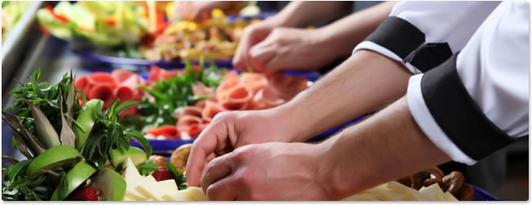
SAMPLE PROFILE

Slide 12
SAMPLE PROFILE OF RESPONDENTS AT THE VENUES

Slide 13
SAMPLE PROFILE RESPONDENTS(1)
Base: all respondents 345
Restaurants
Base: all respondents 345
Years of Experience

Slide 14
SAMPLE PROFILE RESPONDENTS(2)
Occupation of respondent | #
Base | 345*
Owner | 87*
HR Staff | 28*
Venue Manager | 224*
Head Chef | 1*
Supervisor | 1*
Financial manager | 1*
Manager Assistant | 2*
Accountant | 1*
*Absolute Number
Restaurants
Base: all respondents 345

Slide 15
SAMPLE PROFILE OF VENUES

Slide 16
SAMPLE PROFILE TYPE OF BUSINESS(1)
Base: all respondents 345 at the 345 venues

Slide 17
SAMPLE PROFILE TYPE OF BUSINESS(2)
Fast Food
Base: all respondents at the Fast Food category 45
Restaurants
Base: all respondents at the restaurant Category 150
Coffee shops
Base: all respondents at the Coffee shop Category 81
Type of business | Sample
Base | 345*
Restaurants (4, 3, 2& 1 stars) | 150*
Coffee shop(3, 2, 1 stars) | 81*
Entertainment City | 14*
Fast Food(3, 2, 1 stars) | 45*
Others Location** | 55*
Absolute Number
** Outside Amman

Slide 18
SAMPLE PROFILE NOTES TO BE CONSIDERED
Kindly while going through the report consider the following points:
Sample size = 345 respondents at different venues; including the following categories(Restaurants 150, Coffee shops 81, Entertainment Cities 14, Fast Food 45, Other Locations 55).
In these 345 venues we have 7,096 staff (in total), including 2,169 foreigner staff (which 31%of total employees) & 4,927 Local staff (which 69%of total employees); distributed as follows:
Category |  | # of venues | # of all staff | Locals | Foreigners
Restaurant Category | Restaurant 4 stars | 20 | 1,019 | 615 | 404
 | Restaurant 3 stars | 46 | 1,312 | 926 | 386
 | Restaurant 2 stars | 55 | 1,226 | 728 | 498
 | Restaurant 1 star | 29 | 380 | 225 | 155
Total |  |  | 3,937 | 2,494 | 1443
Coffee Shop Category | Coffee shops 3 stars | 6 | 172 | 135 | 37
 | Coffee shops 2 stars | 40 | 454 | 288 | 166
 | Coffee shops 1 star | 35 | 332 | 187 | 145
Total |  |  | 958 | 610 | 348
Entertainment Cities |  | 14 | 433 | 414 | 19
Fast Food Category | Fast Food 3 stars | 1 | 36 | 35 | 1
 | Fast Food 2 stars | 14 | 406 | 340 | 66
 | Fast Food 1 star | 30 | 268 | 225 | 43
Total |  |  | 710 | 600 | 110
Other Locations |  | 55 | 1,058 | 809 | 249

Slide 19

General Shopping Behavior
LOCAL VS. FOREIGNER STAFF

Slide 20
STAFF IN RESTAURANTS CATEGORY(1)
Within the 345 venues have been targeted in this project there is 7,096 employees. 3,937 employees in the “Restaurant Category”.
Out of these 3,937 there is 2,494 local staff & 1,443 foreign staff.
The below table details how these figures are distributed:
Category |  | # of all staff (Abs Value) | % of total staff in this category | Locals (Abs Values) | % of total local staff in this category | Foreigners (Abs values) | % of total foreigner staff in this category
Restaurant Category | Restaurant 4 stars | 1,019 | 26 | 615 | 25 | 404 | 28
 | Restaurant 3 stars | 1,312 | 33 | 926 | 37 | 386 | 27
 | Restaurant 2 stars | 1,226 | 31 | 728 | 29 | 498 | 35
 | Restaurant 1 star | 380 | 10 | 225 | 9 | 155 | 11
Total |  | 3,937 |  | 2,494 |  | 1,443
Ref. S1.a How many staff do you have in the venue?
Ref. S1.b How many of the (answer of S1.a)are foreigners?
Notes:
done

Slide 21
STAFF IN RESTAURANTS CATEGORY(2)
As shown below, in all the restaurant –regardless how many stars they hold- locals are more than foreigners.
Category |  | # of all staff (Abs Value) | Locals (Abs Values) | % of (locals/all staff in each sub-category) | Foreigners (Abs values) | % of (foreigners/all staff in each sub-category)
Restaurant Category | Restaurant 4 stars | 1,019 | 615 | 60 | 404 | 40
 | Restaurant 3 stars | 1,312 | 926 | 71 | 386 | 29
 | Restaurant 2 stars | 1,226 | 728 | 59 | 498 | 41
 | Restaurant 1 star | 380 | 225 | 59 | 155 | 41
Total |  | 3,843 | 2,424 |  | 1,419
Ref. S1.a How many staff do you have in the venue?
Ref. S1.b How many of the (answer of S1.a)are foreigners?
Notes:
done

Slide 22
STAFF IN COFFEE SHOP CATEGORY(1)
Within the 345 venues have been targeted in this project there is 7,096 employees. 958 employees in the “Coffee shop Category”.
Out of these 958 there is 610 local staff & 348 foreign staff.
The below table details how these figures are distributed:
Category |  | # of all staff | % of total staff in this category | Locals | % of total local staff in this category | Foreigners | % of total local staff in this category
Coffee Shop Category | Coffee shops 3 stars | 172 | 18 | 135 | 22 | 37 | 11
 | Coffee shops 2 stars | 454 | 47 | 288 | 47 | 166 | 48
 | Coffee shops 1 star | 332 | 35 | 187 | 31 | 145 | 42
Total |  | 958 |  | 610 |  | 348
Ref. S1.a How many staff do you have in the venue?
Ref. S1.b How many of the (answer of S1.a)are foreigners?
Notes:
done

Slide 23
STAFF IN COFFEE SHOP CATEGORY(2)
All the category have more % of local staff than foreigners.
Category |  | # of all staff | Locals | % of (locals/all staff in each sub-category) | Foreigners (Abs values) | % of (foreigners/all staff in each sub-category)
Coffee Shop Category | Coffee shops 3 stars | 172 | 135 | 78 | 37 | 22
 | Coffee shops 2 stars | 454 | 288 | 63 | 166 | 37
 | Coffee shops 1 star | 332 | 187 | 56 | 145 | 44
Total |  | 958 | 610 |  | 348
Ref. S1.a How many staff do you have in the venue?
Ref. S1.b How many of the (answer of S1.a)are foreigners?
Notes:
done

Slide 24
STAFF IN ENTERTAINMENT CITIES CATEGORY
Within the 345 venues have been targeted in this project there is 7,096 employees. 433 employees in the “Entertainment Cities Category”.
Out of these 433 there is 414 local staff & 19 foreign staff.
96% of this category’s staff are locals where foreigners represent only 4% of all the staff.
Category | # of all staff | Locals | % 0f (locals/all staff) | Foreigners | % of (foreigners /all staff)
Entertainment Cities | 433 | 414 locals | 96 | 19 foreigners | 4
Ref. S1.a How many staff do you have in the venue?
Ref. S1.b How many of the (answer of S1.a)are foreigners?
Notes:
done

Slide 25
STAFF IN FAST FOOD CATEGORY(1)
Within the 345 venues have been targeted in this project there is 7,096 employees. 710 employees in the “Fast Food Category”.
Out of these 710 there is 600 local staff & 110 foreign staff.
The below table details how these figures are distributed:
Category |  | # of all staff | % of total staff in this category | Locals | % of total local staff in this category | Foreigners | % of total local staff in this category
Fast Food Category | Fast Food 3 stars | 36 | 5 | 35 | 6 | 1 | 1
 | Fast Food 2 stars | 406 | 57 | 340 | 57 | 66 | 60
 | Fast Food 1 star | 268 | 38 | 225 | 38 | 43 | 39
Total |  | 710 |  | 600 |  | 110
Ref. S1.a How many staff do you have in the venue?
Ref. S1.b How many of the (answer of S1.a)are foreigners?
Notes:
done

Slide 26
STAFF IN FAST FOOD CATEGORY(2)
As shown below, Fast food 2 stars has 84% of total staff of this sub-category locals where 16% foreigners, etc.
Category |  | # of all staff | Locals | % of (locals/all staff in each sub-category) | Foreigners (Abs values) | % of (foreigners/all staff in each sub-category)
Fast Food Category | Fast Food 3 stars | 36 | 35 | 97 | 1 | 3
 | Fast Food 2 stars | 406 | 340 | 84 | 66 | 16
 | Fast Food 1 star | 268 | 225 | 84 | 43 | 16
Total |  | 710 | 600 |  | 110
Ref. S1.a How many staff do you have in the venue?
Ref. S1.b How many of the (answer of S1.a)are foreigners?
Notes:
done

Slide 27
STAFF IN OTHER LOCATION CATEGORY
Within the 345 venues have been targeted in this project there is 7,096 employees. 1,058 employees in the “Other Location Category”.
Out of these 1,0578 there is 809 local staff & 249 foreign staff.
76% of all the staff over here are locals, where 24% are foreigners.
Category | # of all staff | Locals | % of (locals/ all staff) | Foreigners | % of (foreigners/all staff)
Other Locations | 1,058 | 809 | 76 | 249 | 24
Ref. S1.a How many staff do you have in the venue?
Ref. S1.b How many of the (answer of S1.a)are foreigners?
Notes:
done

Slide 28
INFO ABOUT THE LOCAL STAFF
At the total level 18% of all local staff represent “waiter/waitress” staff, 7% “Chef Assistant”, 7% “Kitchen Steward employees”, & 7% “Food preparation Assistant”.
 | Total | Restaurant Category |  |  |  | Coffee Shops Category |  |  | Entertainment City | Fast Food Category |  |  | Other Locations
 |  | 4 stars | 3 stars | 2 stars | 1 star | 3 stars | 2 stars | 1 star |  | 3 stars | 2 stars | 1 star
Base: Total number of staff | 4927* | 615* | 926* | 728* | 225* | 135* | 288* | 187* | 414* | 35* | 340* | 225* | 809*
Waiter/Waitress | 18 | 16 | 28 | 17 | 7 | 31 | 30 | 24 | 5 | 9 | 8 | 7 | 17
Chef assistant | 7 | 5 | 12 | 8 | 7 | 7 | 3 |  | 3 |  | 6 | 2 | 6
Kitchen steward employee | 7 | 8 | 2 | 7 | 4 | 22 | 10 | 4 | 1 |  | 17 | 9 | 10
Food preparation Assistant | 7 | 10 | 5 | 5 | 11 | 5 | 1 | 1 | 1 | 14 | 5 | 35 | 8
Restaurant Manager | 6 | 3 | 2 | 6 | 8 | 1 | 10 | 7 | 6 |  | 6 | 15 | 7
Accountant | 6 | 3 |  | 6 | 11 |  | 6 | 5 | 12 | 14 | 6 | 16 | 6
Housekeeping | 6 | 4 | 7 | 5 | 8 | 3 | 2 | 7
Head Chef | 5 | 3 | 7 | 5 | 10 | 3 | 3 | 1 | 2 | 3 | 6 | 1 | 5
Busboy | 5 | 6 | 14 | 2 | 4 |  | 3 | 6 | 4 | 9 | 1 |  | 1
Ref. S1.c Kindly list the local employees’ information required below as groups
*Absolute Number
Notes:
done

Slide 29
INFO ABOUT THE LOCAL STAFF
Ref. S1.c Kindly list the local employees’ information required below as groups
Notes:
done

Slide 30
INFO ABOUT THE LOCAL STAFF
Ref. S1.c Kindly list the local employees’ information required below as groups
Notes:
done

Slide 31
INFO ABOUT THE LOCAL STAFF
As shown in the previous slides males is the dominant local gender in all of the position. However we see that accountant –which is a desk job- has a higher % of females than other positions.
Ref. S1.c Kindly list the local employees’ information required below as groups
Notes:
done

Slide 32
WHY MALES IS THE DOMINANT GENDER IN THIS SECTOR?
Base: Abs values , # of males more than females
Head chef: 154
Chef assistant: 122
Food preparation Assis: 98
Kitchen steward employee: 105
Restaurant Manager: 201
Housekeeping.: 102
Waiter/waitress: 181
Busboy: 50
Accountant: 136
Ref. S1.f Why males are more than females?
Notes:
done

Slide 33
INFO ABOUT THE FOREIGN STAFF
23% of the 2,169 foreigner staff are “housekeeping” staff, 20% are “waiter/waitress”, etc..
 | Total | Restaurant Category |  |  |  | Coffee Shops Category |  |  | Entertainment City | Fast Food Category |  |  | Other Locations
 |  | 4 stars | 3 stars | 2 stars | 1 star | 3 stars | 2 stars | 1 star |  | 3 stars | 2 tars | 1 star
Base: No. of foreign staff | 2169* | 404* | 386* | 498* | 155* | 37* | 166* | 145* | 19* | 1* | 66* | 43* | 249*
Housekeeping | 23 | 26 | 37 | 21 | 14 | 27 | 14 | 28 | 53 | 100 | 12 | 14 | 16
Waiter/Waitress | 20 | 12 | 20 | 23 | 12 | 19 | 39 | 15 |  |  | 24 | 2 | 22
Kitchen steward employee | 12 | 15 | 9 | 13 | 4 | 24 | 13 | 5 | 21 |  | 27 | 12 | 10
Hubbly bubbly boy “Argela” | 8 | 2 | 6 | 12 | 2 | 19 | 7 | 30 | 11 |  |  |  | 6
Food preparation Assistant | 7 | 14 | 1 | 2 | 23 | 3 | 4 |  |  |  | 9 | 53 | 6
Chief assistant | 6 | 6 | 8 | 4 | 13 | 3 | 4 | 1 |  |  |  | 2 | 8
Busboy | 4 | 2 | 9 |  | 8 |  | 2 | 5 |  |  |  |  | 7
Head Chef | 3 | 3 | 6 | 1 | 5 |  | 3 |  |  |  | 9 | 2 | 6
Sous Chef | 3 | 5 |  | 7 | 2 |  |  | 6 |  |  | 3
Captain/Floor manager | 3 | 5 |  | 3 | 1 | 5 | 1 | 2 |  |  | 2 | 2 | 9
Ref. S1.g Kindly list the Foreign employees’ information required below.
* Absolute values
Notes:
done

Slide 34
Info about the Foreign Staff
Gender
Ref. S1.g Kindly list the Foreign employees’ information required below.
Notes:
done

Slide 35
Info about the Foreign Staff
Gender
Ref. S1.g Kindly list the Foreign employees’ information required below.
Notes:
done

Slide 36
Info about the Foreign Staff
Gender
As shown in the previous slides males is also the dominant foreigner gender in all of the positions.
Ref. S1.g Kindly list the Foreign employees’ information required below.
Notes:
done

Slide 37
Info about the Foreign Staff
Nationality
47% of the foreigner head chefs are “Egyptian” while at the same time 61% of sous chef are “Egyptian”
Ref. S1.g Kindly list the Foreign employees’ information required below.
Notes:
done

Slide 38
Info about the Foreign Staff
Nationality
Ref. S1.g Kindly list the Foreign employees’ information required below.
Notes:
done

Slide 39
Info about the Foreign Staff
Nationality
Ref. S1.g Kindly list the Foreign employees’ information required below.
Notes:
done

Slide 40
Info about the Foreign Staff
Nationality
Ref. S1.g Kindly list the Foreign employees’ information required below.
Notes:
done

Slide 41
Info about the Foreign Staff
Nationality
As shown in the previous charts the Egyptian nationality is the dominant nationalities for all the mentioned positions.
Ref. S1.g Kindly list the Foreign employees’ information required below.
Notes:
done

Slide 42
Local Vs. Foreign Staff (for some positions)
Notes:
done

Slide 43
Local Vs. Foreign Staff (for some positions)
Notes:
done

Slide 44
Local Vs. Foreign Staff (for some positions)
Notes:
done

Slide 45

General Shopping Behavior
REASONS BEHIND RECRUITING LOCALS VS. FOREIGNERS

Slide 46
IF THERE IS FOREIGNER STAFF AT THE VENUE
Within the 345 venues had been interviewed there is 264 of them having foreigner staff in their venues. As shown in the below table, Restaurants 2 stars is the one includes the largest stake of them, followed by Restaurant 3 stars, Other Locations, Coffee shops 1 & 2 star, etc.
In total, almost half of the respondents disclosed that the reasons behind recruiting foreigners are: “foreigners accept lower wages for long working hours”, “foreigner are humble, they accept any task/position they are assigned to even if it's considered a lower one”, & “foreigners has the attribute of Stability, they are committed to their work”.
Reasons behind recruiting Foreigners | Total | Restaurant Category |  |  |  | Coffee shops |  |  | Entertainment City | Fast Food |  |  | Other Locations
 |  | 4 stars | 3 stars | 2 stars | 1 star
 |  |  |  |  |  | 3 stars | 2 stars | 1 star
 |  |  |  |  |  |  |  |  |  | 3 stars | S tars | 1 star
Base(venues which has foreigner staff) | 264* | 20* | 38* | 52* | 21* | 6* | 30* | 31* | 5* | 1* | 12* | 16* | 32*
Accept lower wages for long working hours | 53 | 55 | 55 | 44 | 76 |  | 17 | 84 | 60 |  | 25 | 75 | 63
Humble, they accept any task/position they are assigned to even if it's considered a lower one | 48 | 45 | 32 | 52 | 81 | 33 | 27 | 42 | 40 | 100 | 42 | 44 | 78
Stability, they are committed to their work | 47 | 45 | 58 | 50 | 38 | 50 | 43 | 68 | 20 | 100 |  | 38 | 41
Patient, capable to work under pressure & for long working hour | 43 | 35 | 26 | 48 | 38 | 33 | 30 | 45 | 20 |  | 75 | 63 | 56
Highly Skilled | 37 | 30 | 34 | 29 | 52 | 33 | 37 | 87 | 20 |  | 17 | 19 | 19
The local people don't like to work hard and there's no commitment to the work | 8 |  | 16 | 4 | 29 |  |  |  |  | 100 | 8 | 6 | 16
There's no local people want to work | 8 |  | 5 | 21 |  |  | 17 | 10
Passionate, they love what they are doing | 6 | 10 | 5 | 10 |  |  | 3 | 13 |  |  |  |  | 3
There's no stability for local people | 5 |  | 3 | 6 | 5 |  | 3 |  | 20 |  |  | 19 | 6
They don't have culture of shame | 3 | 5 | 13 |  |  |  |  |  | 40 |  |  |  | 3
Committed to working | 3 |  | 3 | 8 |  |  |  | 3 |  |  |  |  | 6
Ref. S.2a What are the reasons behind recruiting foreigner at your venue
Notes:
done

Slide 47
IF 100% OF THE STAFF IS LOCAL
Within the 345 venues had been interviewed there is 81 of them having local staff only in their venues. As shown in the below table, Coffee shops 3 stars category does have foreigner staff, it is not 100% having only locals. Fast Food 1 star & other location category are the ones containing the largest stake of them.
In total, the majority address that the reason behind recruiting locals only is because of the goal to encourage the local employment.
Reasons behind recruiting locals ONLY | Total | Restaurant Category |  |  |  | Coffee shops |  |  | Entertainment City | Fast Food |  |  | Other Locations
 |  | 4 stars | 3 stars | 2 stars | 1 star
 |  |  |  |  |  | 3 stars | 2 stars | 1 star
 |  |  |  |  |  |  |  |  |  | 3 stars | 2 stars | 1 star
Base(venues which has LOCAL staff only) | 81* | 0* | 8* | 3* | 8* | 0* | 10* | 4* | 9* | 0* | 2* | 14* | 23*
Encourage local employment | 33 |  | 50 |  | 13 |  | 20 | 25 | 33 |  | 50 | 50 | 35
Highly Skilled | 20 |  | 50 | 33 | 13 |  | 50 | 25 | 33 |  |  | 7
Polite in dealing with the customers | 11
 |  |  | 25 |  |  |  | 10 |  | 22 |  |  | 21 | 4
Difficulty permits of foreign workers | 11 |  | 13 |  | 38 |  | 10 |  |  |  |  |  | 17
Humble, they accept any task/position they are assigned to even if it's considered a lower one | 10 |  | 38 |  | 13 |  |  | 25 |  |  |  | 14 | 4
Rejection of the Ministry of tourism to get expatriate workers | 9 |  |  | 33 | 13 |  | 10 |  | 11 |  |  |  | 13
Patient, capable to work under pressure & for long working hour | 7 |  | 38 |  | 13 |  |  |  |  |  |  | 7 | 4
Accept lower wages for long working hours | 7 |  | 38 |  | 13 |  | 10 |  |  |  |  | 7
Stability, they are committed to their work | 7 |  |  | 33 |  |  | 10 | 25 |  |  |  | 7 | 9
High cost to the expatriate workers | 6 |  |  |  | 13 |  |  |  | 11 |  |  |  | 13
Ref. S.2b What are the reasons behind recruiting Locals ONLY
Notes:
done

Slide 48

IF 100% OF THE STAFF IS FOREIGNER
Only 2 venues out of the 345 ones recruit only foreigners.
Fast Food 2 starts made it clear that the reason behind this scenario is: local staff don’t commit to their work in this industry. Whereas Coffee shops 2 stars said the same in addition to what locals suffers because of the culture of shame.
1 Fast Food
Non-commitment of local staff
2 venues have only foreigner staff
1 coffee shop
Non-commitment of local staff
& culture of shame
Ref. S.2c All of your employees are foreigners, why don’t you recruit locals?
Notes:
done

Slide 49
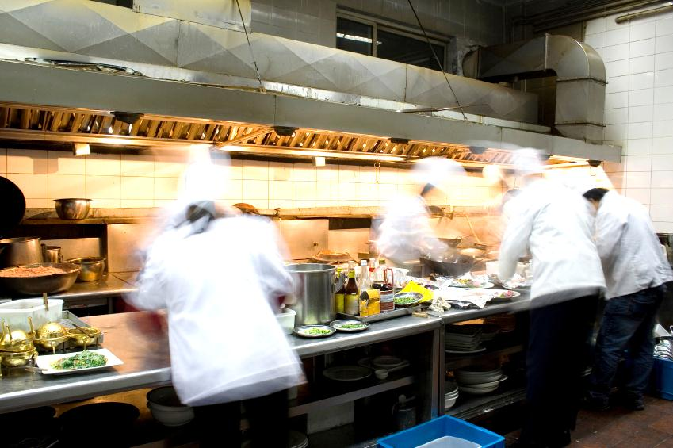
General Shopping Behavior
WHO COSTS MORE? RECRUITING LOCALS OR FOREIGNERS

Slide 50
WHO COSTS MORE TO RECRUIT? LOCAL OR FOREIGNER
In total, 54% of the sample thinks that recruiting foreigners costs more, whereas 40% thinks the opposite. 6% of the sample thinks both costs the same. Despite this fact we have 264 venues recruiting foreigners due to the previously mentioned reasons.
Restaurant Category: 4 stars, 3 stars & 1 star: majority thinks that foreigner costs more- although they are the ones who recruits foreigners-, while 2 stars majority think that Local costs more. Coffee shop Category: 3 & 2 stars majority thinks that foreigner costs more while 1 star think the opposite. Fast Food & Other location majority thinks that foreigner costs more. At the same time Entertainment city category 50% thinks foreigner & the other 50% think that Local costs more.
Base: absolute value= Total:345
Res 4 stars: 20
Res 3 stars: 46
Res 2 stars:55
Res 1 star:29
Coffee shop 3 stars:6
Coffee shop 2 stars:40
Coffee shop 1 star:35
Entertainment City:14
Fast Food 3 stars:1
Fast Food 2 stars:14
Fast Food 1 star:30
Other Location:55
Ref. S2.d In your opinion, who do you think it costs more: hiring a foreigner or a local staff?
Notes:
done

Slide 51
Why Locals costs more?
138 respondents out of the 345 answered with “local costs more”.
In total, 80% stated that the reason behind their thoughts is that locals ask for high salary compared to their work experience.
Base: absolute value= Total:138
Ref. S2.e Why hiring a local costs more than hiring a foreigner?
Notes:
done

Slide 52
Why Locals costs more?
138 respondents out of the 345 answered with “local costs more”. The following box highlight the number for each category that did the same.
Respondents at Coffee shops 3 stars: all of them the 2 respondents disclosed the same reason which is “they ask for high salary compared with their work experience”, same as Fast Food 2 stars.
Base: absolute value= Total:138 ones who said locals cost more
Res 4 stars: 9
Res 3 stars: 20
Res 2 stars:29
Res 1 star:6
Coffee shop 3 stars:2
Coffee shop 2 stars:10
Coffee shop 1 star:26
Entertainment City:7
Fast Food 3 stars:0
Fast Food 2 stars:2
Fast Food 1 star:13
Other Location:14
Ref. S2.e Why hiring a local costs more than hiring a foreigner?
Notes:
done

Slide 53
Why Foreigner costs more?
186 respondents out of the 345 answered with “foreigner costs more”.
99% out of the total (186 respondents who said foreigners cost more) stated that the reason behind their thoughts is that Foreigners need more expenses to be paid, such as: housing, transportation. In other words they are more expensive than locals
Base: absolute value= Total:186 who answered with foreigners cost more than locals
Ref. S2.f Why hiring a foreigner costs more than hiring a local?
Notes:
done

Slide 54
Why Foreigner costs more?
The reason “Foreigners need more expenses to be paid, such as: housing, transportation. In other words they are more expensive than locals” is almost the one all respondents mention it.
Base: absolute value= Total:186 ones who said foreigners cost more
Res 4 stars: 10
Res 3 stars: 22
Res 2 stars:25
Res 1 star:23
Coffee shop 3 stars:3
Coffee shop 2 stars:25
Coffee shop 1 star:0
Entertainment City:7
Fast Food 2 stars:1
Fast Food 1 star:12
Other Location:17
Ref. S2.f Why hiring a foreigner costs more than hiring a local?
Notes:
done

Slide 55
Why both costs the same?
In total, 21 respondents at venues stated that both costs the same.
Reasons behind this is listed below.
Reasons behind this
It is the same cost except in the case of the foreign chef who ask for a very high wage
Same since local employee asks for a high wage while cost of a foreigner employee is higher than local one (e.g. labour license and accommodation)
Ref. S2.f Why hiring a foreigner costs more than hiring a local?
Notes:
done

Slide 56
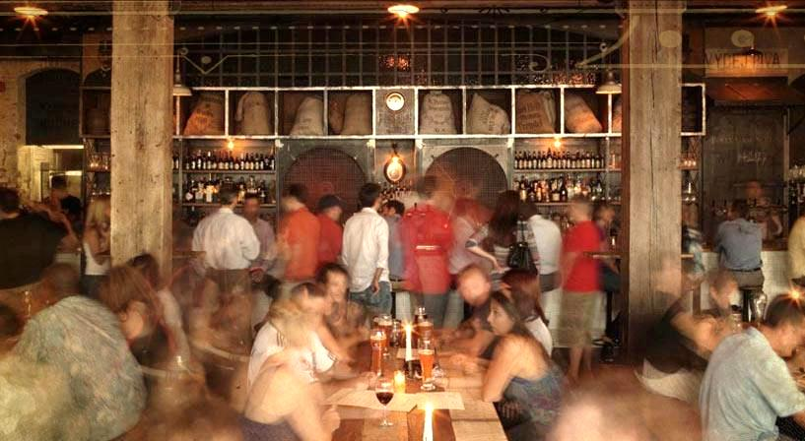
General Shopping Behavior
CURRENT & FUTURE STATUS OF THIS INDUSTRY

Slide 57
SHORTAGE WITNESSED AT THE PRESENT
As shown in the below chart, in total there is a shortage in “waiter/waitress” position. Fast food 3 star is the most who suffer from this problem.
The least shortage is in the “food preparation assistant” position & the most who is exposed to it is Coffee shops 3 stars.
Base: absolute value= Total:345
Res 4 stars: 20
Res 3 stars: 46
Res 2 stars:55
Res 1 star:29
Coffee shop 3 stars:6
Coffee shop 2 stars:40
Coffee shop 1 star:35
Entertainment City:14
Fast Food 3 stars:1
Fast Food 2 stars:14
Fast Food 1 star:30
Other Location:55
Ref. S.3a At the present, which of the following positions do you face shortage? And, what are the reasons behind such a shortage?
Notes:
done

Slide 58
REASONS BEHIND THIS SHORTAGE
As shown in the below chart, “Lack of local employment” is the common reason behind the shortage of all the down listed positions.
32% of respondents who stated there is a shortage in “chef assistant” position (22 respondents did) disclosed that the reason behind this is “Lack of local employment”, same for 30% of who said there is a shortage in “head chef” position (23 respondents)., etc…
64% of the 47 respondents who disclosed a shortage in the housekeeping position stated that the reason behind this shortage is “culture of shame”.
Base: absolute value= who stated shortage for
“waiter/waitress”: 64
“Housekeeping”: 47
“Food preparation assistant”: 18
“Kitchen steward employee”:30
“Head Chef”:23
“Chef Assistant”:22
Ref. S.3a At the present, which of the following departments do you face shortage? And, what are the reasons behind such a shortage?
Notes:
done

Slide 59
THE NEED FOR MORE EMPLOYEES IN THE FUTURE
As shown below, Restaurant 2 stars is the most part who needs more employees during the upcoming 3 years, followed by Coffee shops 3 stars, entertainment cities, Fast food 2 stars, …
Whereas, the most who stated there is less need for more employees in the future are: fast Food 3 stars (1 venue), Restaurant 4 stars, Coffee shop 1 star, …
Base: absolute value= Total:345
Res 4 stars: 20
Res 3 stars: 46
Res 2 stars:55
Res 1 star:29
Ref. S.3b During the upcoming 3 years, would you need more employees?
If yes, in which departments? What nationality you prefer? And, what are the obstacles (if there is any) to fill this need?
Coffee shop 3 stars:6
Coffee shop 2 stars:40
Coffee shop 1 star:35
Entertainment City:14
Fast Food 3 stars:1
Fast Food 2 stars:14
Fast Food 1 star:30
Other Location:55
Notes:
done

Slide 60
POSITIONS NEEDED IN THE FUTURE
In total, 47% of the respondents who said there would be a need for more employees in the future (which they are 168 respondents) stated that the need would be for “waiter/waitress” position. Whereas 33% said “housekeeping”, 27% stated “Kitchen steward employee”, 24% “head chef”, 23% “chef assistant”, & 23% said “Food preparation Assistant “.
Out of the 47% who said “waiter/waitress” are: 63% Coffee shop 2 stars, 60% “entertainment cities”, 54% “restaurant 2 stars”, 50% “restaurant 4 stars”, …
60% out of the 33% of respondent said the need would be for “housekeeping” is “coffee shop 3 stars”.
Base: absolute value= Total who disclosed that there is a need for more employees:168
Res 4 stars: 6
Res 3 stars: 26
Res 2 stars:37
Res 1 star:12
Coffee shop 3 stars:5
Coffee shop 2 stars:19
Coffee shop 1 star:8
Entertainment City:10
Fast Food 2 stars:12
Fast Food 1 star:17
Other Location:16
Ref. S.3b During the upcoming 3 years, would you need more employees?
If yes, in which positions? What nationality you prefer? And, what are the obstacles (if there is any) to fill this need?
Notes:
done

Slide 61
NATIONALITY PREFERRED FOR THE POSITIONS NEEDED IN THE FUTURE
Ref. S.3b During the upcoming 3 years, would you need more employees?
If yes, in which positions? What nationality you prefer? And, what are the obstacles (if there is any) to fill this need?
Notes:
done

Slide 62
NATIONALITY PREFERRED FOR THE POSITIONS NEEDED IN THE FUTURE
Ref. S.3b During the upcoming 3 years, would you need more employees?
If yes, in which positions? What nationality you prefer? And, what are the obstacles (if there is any) to fill this need?
Notes:
done

Slide 63
NATIONALITY PREFERRED FOR THE POSITIONS NEEDED IN THE FUTURE
Ref. S.3b During the upcoming 3 years, would you need more employees?
If yes, in which positions? What nationality you prefer? And, what are the obstacles (if there is any) to fill this need?
Notes:
done

Slide 64
OBSTACLES TO FILL THE NEED
Base: Abs values , ones who coded the needed positions
Waiter/waitress: 79
Housekeeping: 56
Kitchen steward employee: 45
Head Chef: 40
Chef assist.: 39
Food preparation Assis: 39
Ref. S.3b During the upcoming 3 years, would you need more employees?
If yes, in which positions? What nationality you prefer? And, what are the obstacles (if there is any) to fill this need?
Notes:
done

Slide 65
STATUS OF THE EMPLOYEES TURNOVER
The below chart gives a picture of the status of the turnover for some position respondents have mentioned.
“Housekeeping” & “waiter/waitress” are the most positions witness high turnover.
“Butcher”, “Sous Chef”, “Pastry chef”, & “kitchen steward employee” are the most that witness very low turnover.
Base: absolute value= Times each position was coded to address a turnover in the past
Waiter/Waitress: 121
Kitchen steward employee: 81
Food preparation Assistant:80
housekeeping:77
Chef Assist:63
Head Chef:53
Sous Chef:42
Pastry Chef:39
Butcher:36
Restaurant Manager:35
Ref. S.4.a Within the last 12 months, was it very low, low, medium, high, or very high the amount of employees who left at each department? & what are the reasons behind this?
Notes:
done

Slide 66
REASONS BEHIND THE STATUS OF THE EMPLOYEES TURNOVER
Base: absolute value= Times each position was coded to address a turnover in the past
Waiter/Waitress: 121
Kitchen steward employee: 81
Food preparation Assistant:80
housekeeping:77
Chef Assist:63
Head Chef:53
Sous Chef:42
Pastry Chef:39
Butcher:36
Restaurant Manager:35
Ref. S.4.a Within the last 12 months, was it very low, low, medium, high, or very high the amount of employees who left at each department? & what are the reasons behind this?
Notes:
done

Slide 67

General Shopping Behavior
IS EFFECTIVE TRAINING NEEDED?
THE INCAPABILITY OF LOCAL STAFF.

Slide 68
IS THERE A NEED FOR AN EFFECTIVE TRAINING?
In total 51% thinks there is no need for an effective training.
Base: absolute value= Total:345
Res 4 stars: 20
Res 3 stars: 46
Res 2 stars:55
Res 1 star:29
Coffee shop 3 stars:6
Coffee shop 2 stars:40
Coffee shop 1 star:35
Entertainment City:14
Fast Food 3 stars:1
Fast Food 2 stars:14
Fast Food 1 star:30
Other Location:55
Ref. S5a In your opinion, do you think that employees are in need for effective training?
Notes:
done

Slide 69
TYPE OF TRAINING NEEDED
Out of the 168 respondents -who disclosed that there is a need for an effective training – 28% stated that “waiter/waitress” are the ones who are in need. At the same time 14% out of them said that all positions need an effective training. The last said that all kind of training is needed.
Position | Waiter/Waitress | Food preparation Assistant | Head Chef | Chef Assistant | Captain/floor manager
Base : Absolute values; who thinks there is a need for a training | 46* | 30* | 27* | 22* | 16*
Customer Service | 72 | 13 | 18 | 18 | 69
Theoretical and practical training on the mechanism of works | 11 | 7 | 7 | 14
Food preparation courses for the different types | 9 | 80 | 78 | 45 | 19
*Absolute values
Base:Abs value:
168 who thinks there is a need for a training
Types of the training
Ref. S5.b Could you please list what type of training is needed for each position?
Notes:
done

Slide 70
CAPABILITIES & AVAILABILITY OF LOCAL STAFF
At the total level, the most positions mentioned related to the local labor capabilities are –in order- :
Head chef, Waiter/waitress, Housekeeping, Chef assistant, Food preparation assistant, Kitchen steward employees, busboy & sous chef.
As for the “housekeeping”: 22% out of the 290 “who mentioned housekeeping when they talked about local capabilities” disclosed that local staff are incapable of filling this position.
Base: absolute value=Those are the #s of respondents who mentioned each position in S.6a "mentioned it to comment on the capabilities of local labour"
Head Chef: 298
Waiter/Waitress: 293
Housekeeping: 290
Chef Assist:290
Food preparation Assistant:286
Kitchen steward employee: 286
Busboy:248
Sous Chef:282
Ref. S.6a In your opinion, for the following positions do you think our local labor is capable & available of filling them? If No, kindly provide us with the obstacles behind this incapability.
Notes:
done

Slide 71
REASONS BEHIND THE INCAPABILITY OF LOCAL STAFF
52% of the 65 respondents who mentioned the incapability of local staff to fill the “housekeeping” position stated that reason behind this is (Culture of shame). Same as the majority for the ones who mentioned (Waiter/Waitress), (Kitchen steward employee), & (Busboy) positions.
Majority of the ones mentioned head chef, Food preparation Assistant , Chef assistant & Sous Chef said the reason is “less experience in this area”.
Base: absolute value=Those are the #s of respondents who mentioned each position in S.6a & disclosed that local staff are incapable
Head Chef: 48
Waiter/Waitress: 48
Housekeeping: 65
Chef Assist:31
Food preparation Assistant:34
Kitchen steward employee: 45
Busboy:31
Sous Chef:29
Ref. S.6b If No, kindly provide us with the obstacles behind this incapability.
Notes:
done

Slide 72
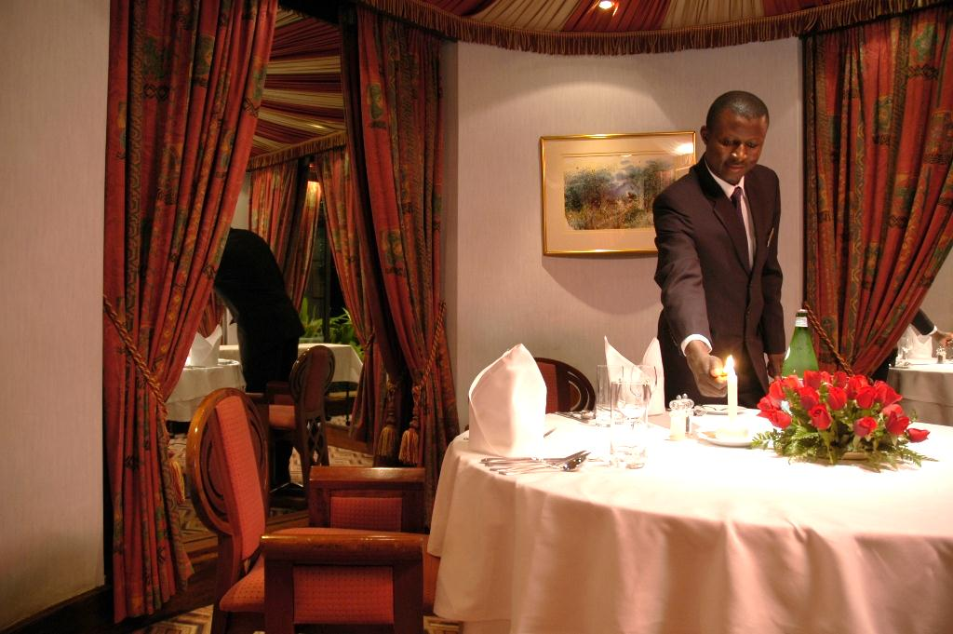
General Shopping Behavior
RECRUITING METHODS

Slide 73
RECRUITING PROCESS
As it is shown below the majority of all the respondent states that word of mouth is the most used method in order to recruit staff.
Word of mouth succeed almost all of the time, & also the same for “Newspaper Ad” & “Internet”.
* Absolute value
 | WORD OF MOUTH | NEWSPAPER ADS | INTERNET
Base: Abs value | 134* | 106* | 46*
Yes | 95 | 91 | 96
No | 5 | 9 | 4
Base: Absolute value: all respondents 345
Ref. S.7a When you have a vacancy(s), what is the process you follow to fill this vacancy(s)?
Ref. S.7b Did you manage to fill the vacancy(s) using the mention method? And why?
Notes:
done

Slide 74
REASONS BEHIND THE RESULT OF THE RECRUITING PROCESS
Reasons behind the success
Reasons behind the Failure
Ref. S.7b Did you manage to fill the vacancy(s) using the mention method? And why?
Notes:
done

Slide 75

BENEFITS GIVEN TO LOCALS VS. FOREIGNERS
LOCAL HOSPITALITY GRADUATE

Slide 76
BENEFITS OFFERED BY THE MANAGEMENT
As it is shown below, 97% of all the respondents said that they offer “social security” for their employees. This is normal since law obligate them to do so.
81% offer “salary increment” for their staff, whereas 76% said that they offer meals for the staff during their working hours.
Base: (Absolute value): all respondents 345
Ref. S.8a Kindly choose from the following options what kind of benefits the management offers for the employees(both, locals & foreigners)
Ref. S.8b Which of the below statements best describe the benefits given to foreigner employees & local employees?
Notes:
done

Slide 77
LOCAL HOSPITALITY GRADUATE
In total 64% of all respondents answered with no; they don’t have local hospitality graduate.
50% of respondents at Restaurant 4 stars said yes they have while the other 50% said the opposite.
Base: absolute value= Total:345
Res 4 stars: 20
Res 3 stars: 46
Res 2 stars:55
Res 1 star:29
Coffee shop 3 stars:6
Coffee shop 2 stars:40
Coffee shop 1 star:35
Entertainment City:14
Fast Food 3 stars:1
Fast Food 2 stars:14
Fast Food 1 star:30
Other Location:55
Ref. S.9a Do you have any local hospitality graduate working at your business?
Notes:
done

Slide 78
HOW SATISFIED WITH THE LOCAL HOSPITALITY GRADUATE?
As it shown below 81% of the 124 respondents interviewed are satisfied with the local hospitality graduate they do have at their venues.
Business Type | Occupation | How satisfied with the local hospitality graduate
 | Basis: Absolute values If there are LOCAL hospitality Graduate | Satisfied | Dissatisfied
 | 124* | 81 | 6
Restaurant 4 stars | 10* | 60 | 20
Restaurant 3 stars | 20* | 85 | 10
Restaurant 2 stars | 26* | 73 | 8
Restaurant 1 star | 9* | 56
Coffee shops 3 stars | 3* | 67
Coffee shops 2 stars | 17* | 88 | 6
Coffee shops 1 star | 4* | 75 | 25
Entertainment city | 6* | 100
Fast Food 3 stars | 0*
Fast Food 2 stars | 5* | 100
Fast Food 1 star | 6* | 100
Other locations | 18* | 89
*Absolute Values
Top 2 boxes & Bottom 2 boxes are used
Ref. S.9c how satisfied with local hospitality graduate working at your business are you?
Notes:
done

Slide 79
REASONS BEHIND BEING DISSATISFIED WITH THE LOCAL HOSPITALITY GRADUATE
Half of the 8 venues who have local graduate & they are not satisfied with said that the reason behind this is that these graduated people are not that qualified.
*Base: 8 venues who have local graduate & they are not satisfied with.
** very low base
S.9d
You stated that you are dissatisfied with the local hospitality graduate working at your business, could you please tell us the reasons behind this?
Notes:
done

Slide 80
THANK YOU!

